Slide 1
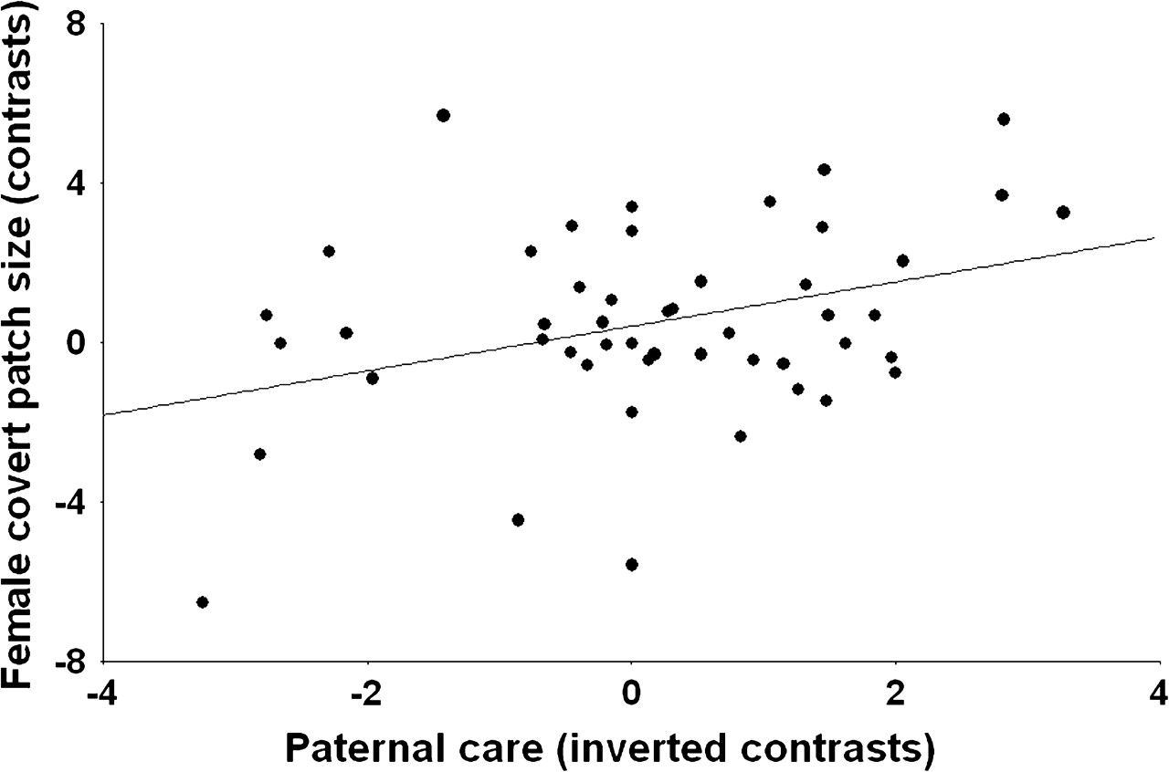

Figure 3 The size of white covert patches in female ducks in relation to male contribution to paternal care: ...
Notes:
Figure 3 The size of white covert patches in female ducks in relation to male contribution to paternal care: independent contrasts. The original male paternal care scores of Scott and Clutton-Brock (1989) are negatively related to male contribution to care, so we multiplied the contrasts by −1 on this graph to facilitate understanding. Zero contrasts are not shown.
Unless provided in the caption above, the following copyright applies to the content of this slide: © The Author 2008. Published by Oxford University Press on behalf of the International Society for Behavioral Ecology. All rights reserved. For permissions, please e-mail: journals.permissions@oxfordjournals.org

